Slide 1
Evolutionary MNCA
Long Term Emergent Dynamics in Evolutionary Multi-Neighborhood CA
Sanyam * Stefano
Østfold University College

Slide 2
Our CA – start state (Mask)
Border (We are using)
if state == 'border':
B = np.zeros((w, h), dtype=int)
B[1:-1, 1:-1] = 1
Random
if state == 'rand':
return np.random.randint(0, 2, (w, h))

Slide 3
CA(inputs = B,S) – Born and Survive rules
Evolve CA on just two inputs, Born and Survive
We keep:
Width 100
Height 100
mask as border
Steps 50

Slide 4
Setting up the rule B[…] and S[…]
Neighbors = Sum(north,east,west,south)
if(currentstate = 0 and neighbor_sum = Born[i]):
Life
if(currentstate = 1 and neighbor_sum = Survive[i]):
Survive
if(neighbors_sum not in B or S):
Death

Slide 5
Evolutionary Computation (EC.py)
Running – python3 EC.py [population] [generation_numbers] [crossover] [generation_loop]
Initial Population – [[B],[S]] where
B = random_list_gnerator(1,8) with random size
S = random_list_gnerator(1,8) with random size
Deflate = cellularautomata(B,S) as cellulatautomata function runs 50 steps of CA and concat to save a file “boardArray.txt” and returns compressed.sizeof() which is deflate value.

Slide 6
Misc parameters for EC
Selection – selects highest deflate value from the run
Crossover(inputs = parent1,parent2) returns [c1,c2] where randomly 1 value from parent1 Born and Survive and from parent2 Born and Survive will get flipped with value between 1 to 8. Also:
c1 = [parent1[0], parent2[1]] OR [B of p1, S of p2]
c2 = [parent2[0], parent1[1]] OR [B of p2, S of p1]

Slide 7
Mutation
Completely new random rule set if (rand() < mu_rate)
Where rand() is random real number between 0 to 1
For our exp I have set it to 0.5 considering rand() as pseudo random generator (ref IBM) then we can say 50% changes we get new rule set whenever mutation is called.

Slide 8
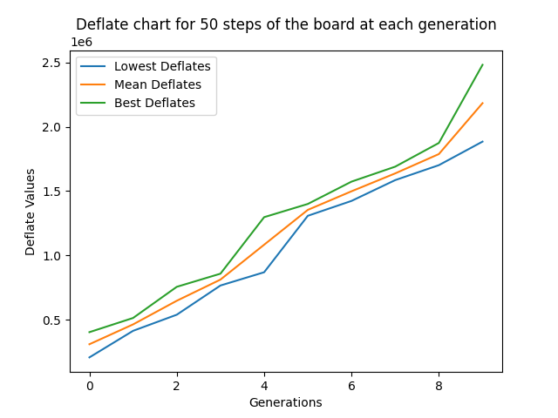
Deflate Plots (1) – P10-G10-C10-L10 (50 CA steps)

Slide 9
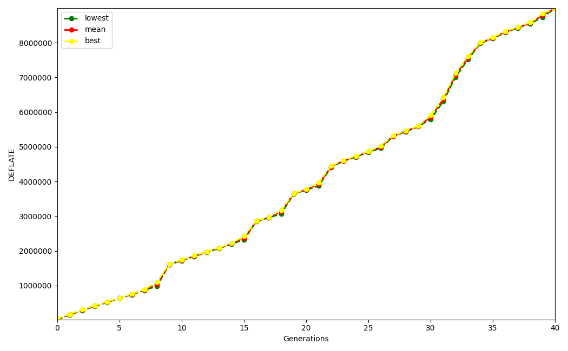
Deflate Plots (2) – P10-G50-C10-L3 (50 CA steps)

Slide 10
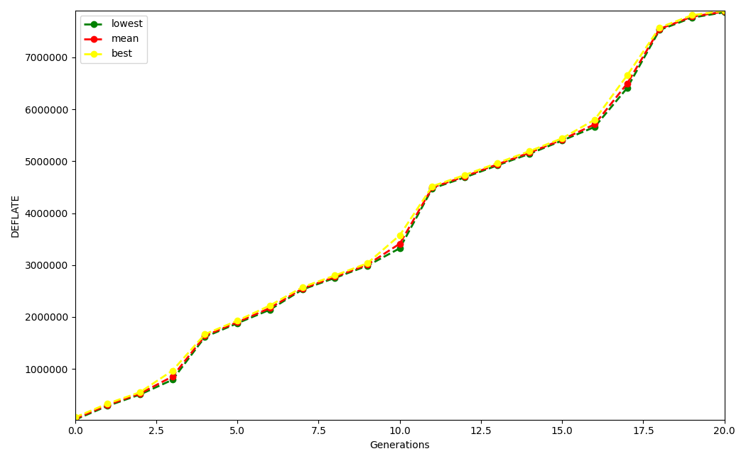
Deflate Plots (3) – P20-G50-C20-L5 (50 CA steps)

Slide 11

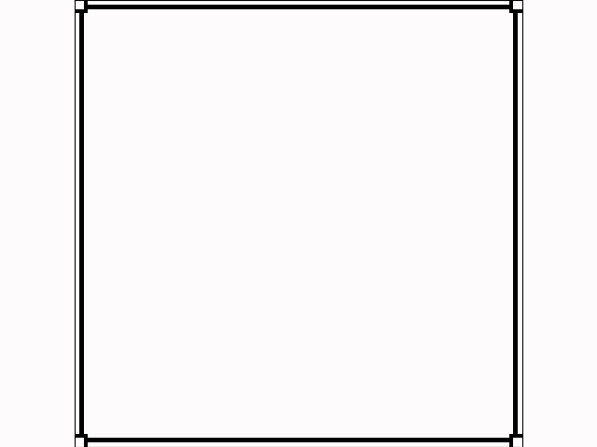
CA outputs – p10g10c10l10 with high mutation (50steps)
CA_Generation_0
lowest
best

Slide 12


CA outputs – p10g10c10l10 with high mutation
CA_Generation_1
lowest
best

Slide 13
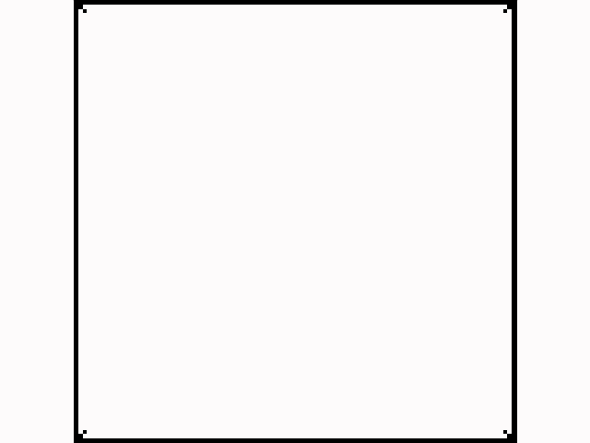

CA outputs – p10g10c10l10 with high mutation
CA_Generation_3
lowest
best

Slide 14


CA outputs – p10g10c10l10 with high mutation
CA_Generation_9
lowest
best

Slide 15
Some of My observations
When changed states (rather than 0,1 adding ‘2’ for Survive) it showed different behavior
Rules show different behavior with different masks, while “border” and “random” masks are evergreen to see the emerging behavior
For example, CA generation 3 on slide 13, the best rule is for “border” mask, however, for diagonal mask, it was too orderly while for random mask, it was similar to life like rule.
If we introduce different states, I strongly think we need to run Evolutionary part again to see new rules that could show emerging behavior, as changing states and keeping the rules (from 2 state CA) same is not helping.
Can we also put a threshold of DEFALTE to some point? So that we do not reach chaotic behaviors? Not sure.

Slide 16

3 state MNCA (Method 1 Changing Rule)
Changing Born and Survive rule for Multi state:
if(self.current_state == 0 and self.neighbors == B[i]):
self.next_state = 1
if(self.current_state == 1 and self.neighbors == S[i]):
self.next_state = 2
if(self.neighbors not in B+S):
self.next_state = 0
B[5, 6, 4]_S[4, 4, 8, 1, 5, 6, 8]_genCA

Slide 17

3 state MNCA (Method 2 Grid Initialisation)
Mask can be changed in order to have multi state values 0,1 and 2, for example our ‘border’ mask will look like:
if state == 'border':
B = np.zeros((w, h), dtype=int)
B[1:-1, 1:-1] = 1
B[2:-2, 2:-2] = 2
return B
B[5, 6, 4]_S[4, 4, 8, 1, 5, 6, 8]_genCA

Slide 18
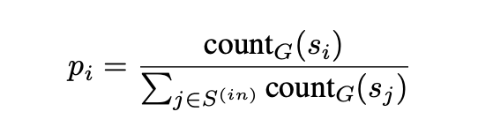
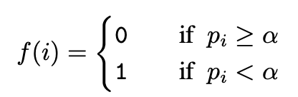
Also tried frequency histogram Refer “visualizing Computation in large scale CA”
Step1 Convert NxN to smaller arrays of 2x2. (Block Shaped of 2)
Input = board_array -> size=100*100
Output = board_array -> size 50*50
Step2

Slide 19
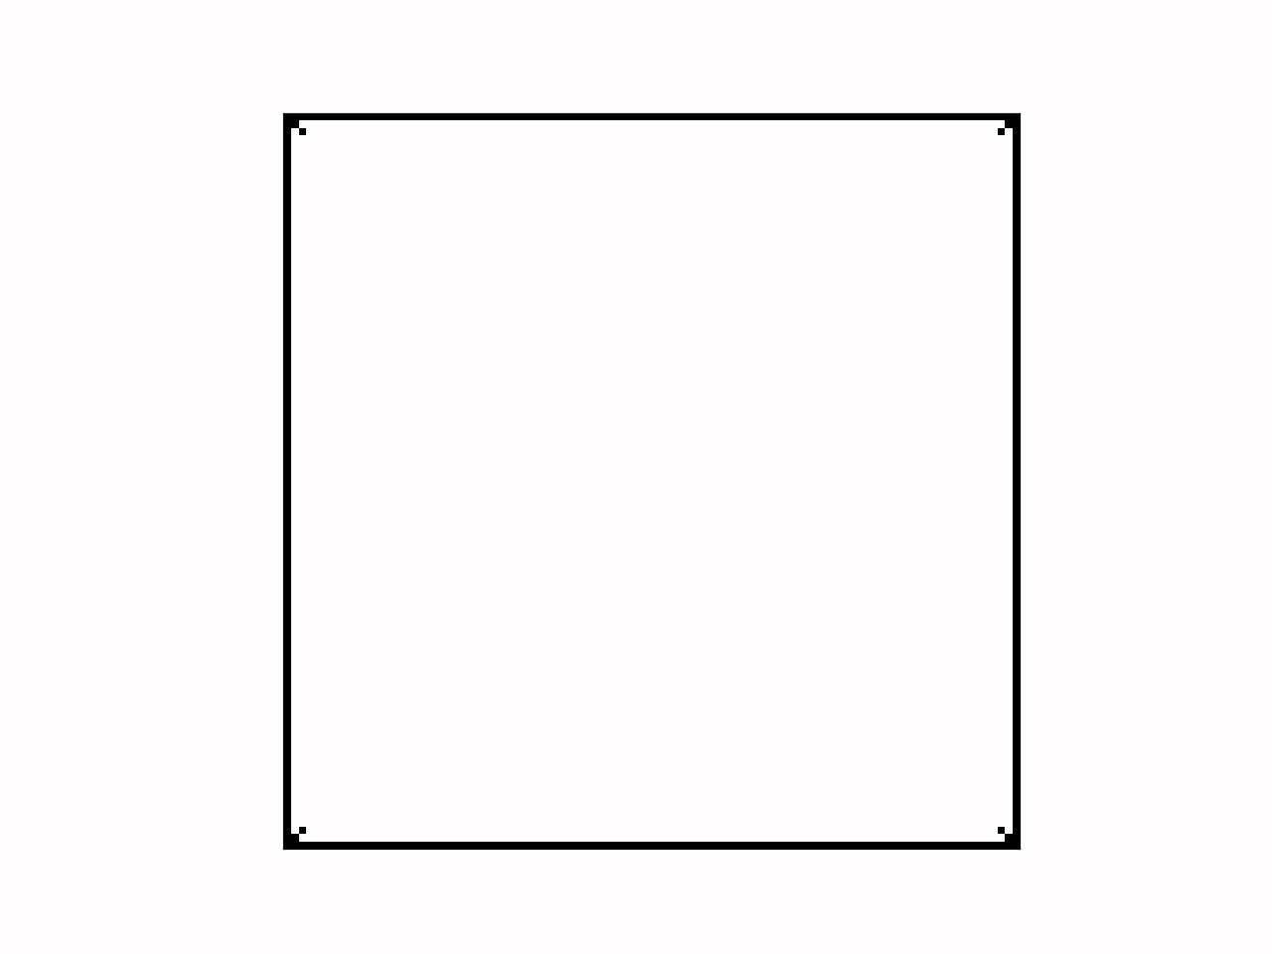

Result of Frequency Histogram (mnca_v3)
Without FH
With FH
Importance of threshold – supercells with low p_{i} with high self information
are mapped with 1, where are commonly occuring states are mapped to 0

Slide 20
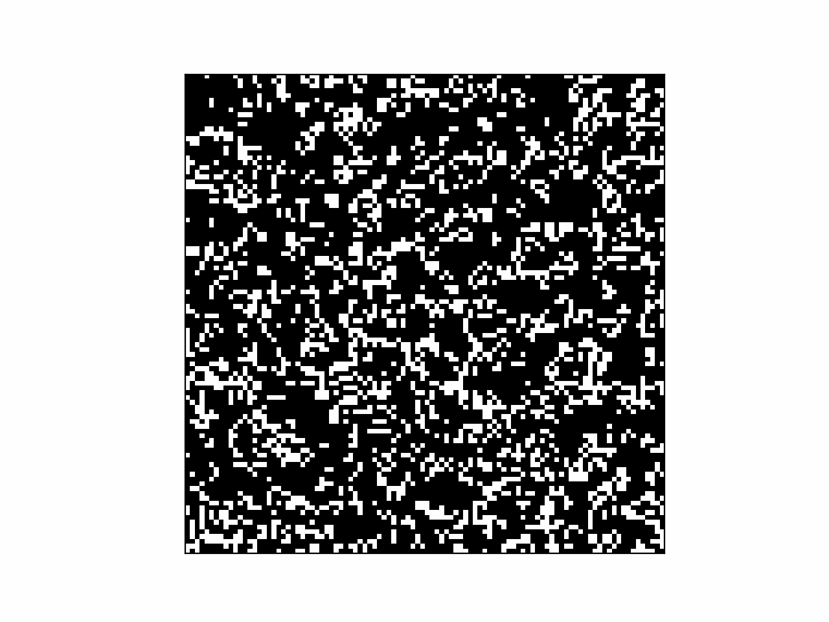
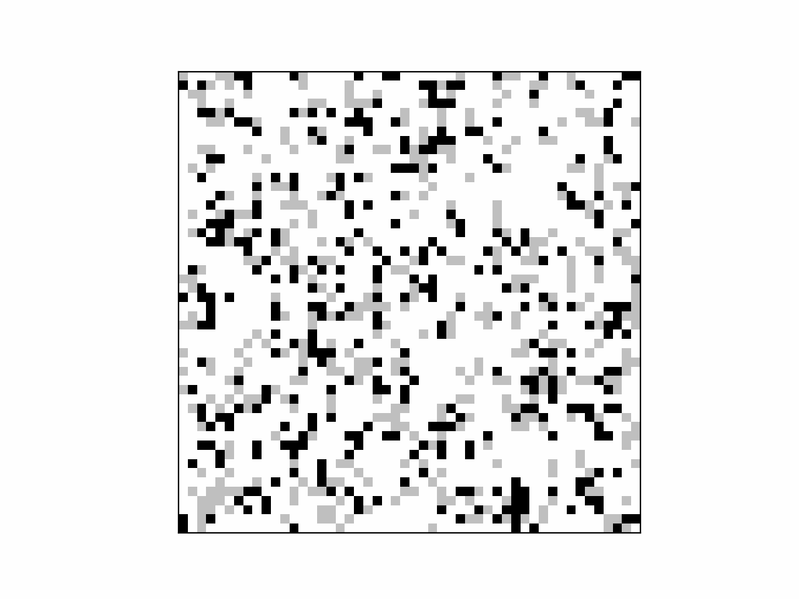
Result of Coarse Graining(mnca_v4)
B3/S23 w/out
B3/S23 with coarse

Slide 21
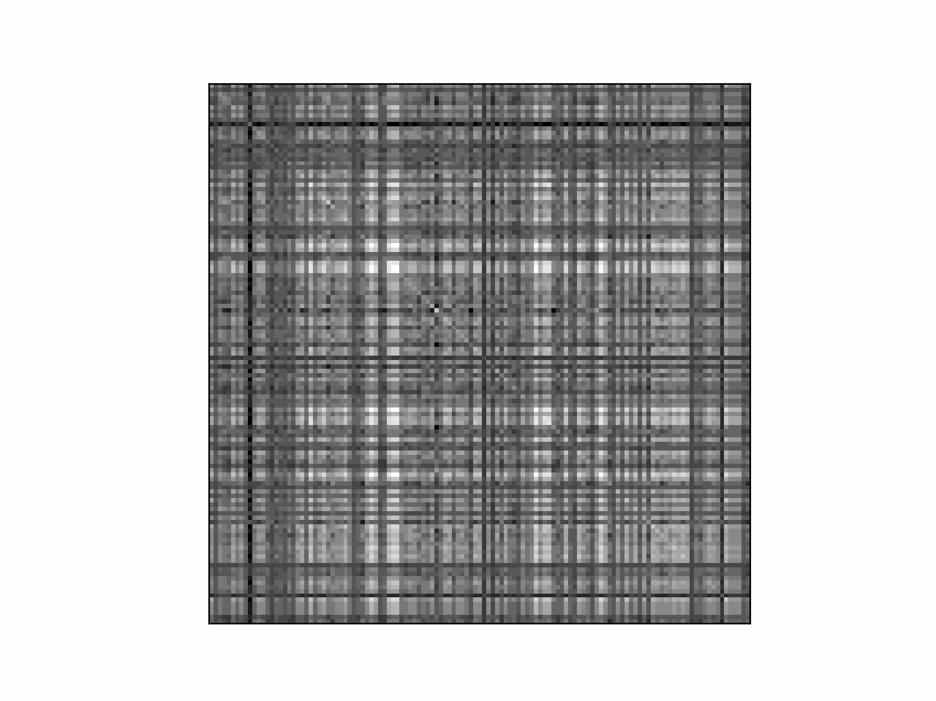
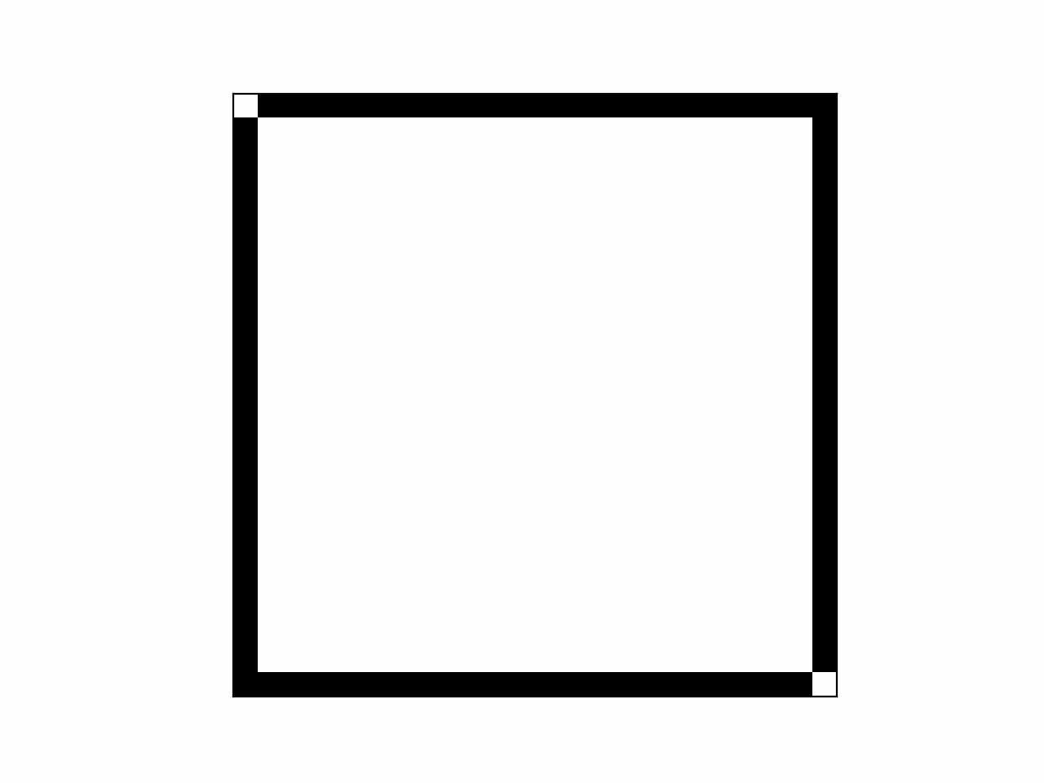

Result of Clustering with 2 methods (mnca_v5)
B3/S23 w/out
B3/S23 with method1
B3/S23 with method2

Slide 22
Further Discussion about comparative analysis (1)
Consider paper “Visualising Computation in Large Scale automata”
There are several approaches include:
Frequency Historgram
Coarse graining
Clustering
Auto Encoder
Idea is to compare a new visualizing technique (we need to think of a visualizing technique that performs better than the existing ones)

Slide 23
Further Discussion about comparative analysis (2)
Consider paper “Evolving Structures in Complex Systems”
We use DEFLATE (upper limit) – A count-based predictor (Which is also a predictor-based metric) according to the reference. (Section IV of the above-mentioned paper)
In order to compare we need to perform the same EC run with:
Joint Compression Technique in the paper (Which is also a predictor-based metric)
Also need to look for Compression based metric (Section III of the above mentioned paper)– similar to DEFLATE

Slide 24
Further Discussion about comparative analysis (3)
Consider paper “HetCA”
Comparison of charts we can look…
Concept of Evolutionary CA
Figure 3
Figure 5

Slide 25
Further Discussion about comparative analysis (4)
In our framework we can have a graph that shows curves for: (keeping number of generations same)
EMNCA with DEFLATE
EMNCA with high mutation
EMNCA with small mutation
EMNCA with large population
EMNCA with small population size
EMNCA with high crossover
EMNCA with small crossover
X-axis: Generatins
Y-axis: DEFLATE values,
Joint Compression
EMNCA with Joint Compression
EMNCA with radius 1,2 and 3
EMNCA with continuous 50 steps compression (DEFLATE+JOINT CMPRESSION)
EMNCA with 50 step compression but with time delta (DEFLATE+JOINT CMPRESSION)
EMNCA with neural network based predictor (Not sure for now)

Slide 26
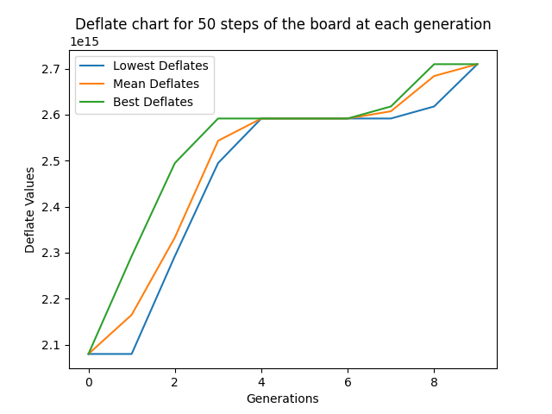
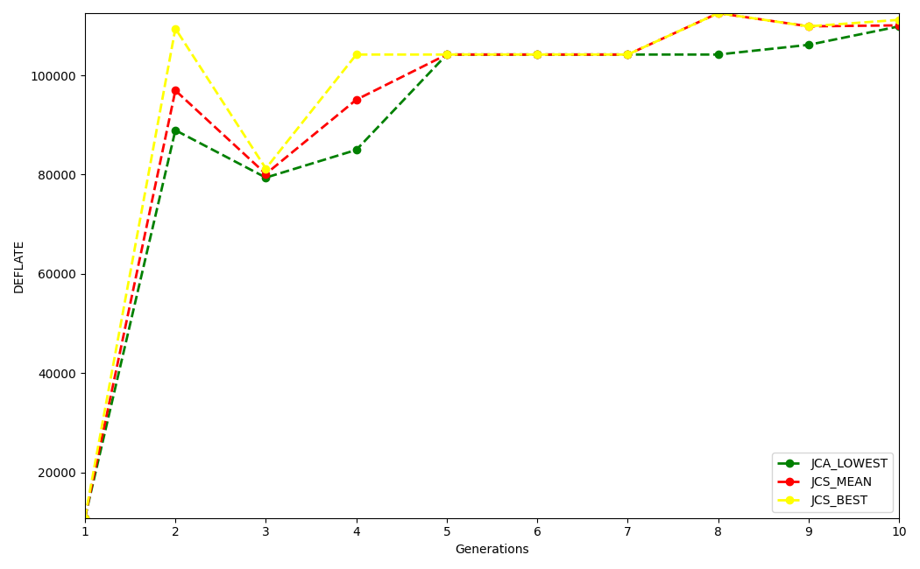
One peculiar observation
DEFLATE score based EMNCA and Joint Compression based score based EMNCA both yields similar DEFLATE vs GENERATION curve. In other words, when I made fitness as MU(Joint Compression Score) it yielded rules according to the upper bound of JCS. I calculated deflate of 50 steps with those rules and quite interestingly DEFLATE vs GENERATIONS curve and Joint Compression Score vs GENERATIONS curve looks quite similar! Check below
Joint Compression Score
DEFLATE

Slide 27
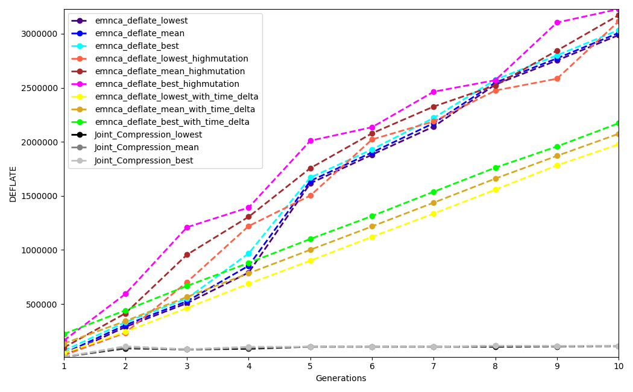
One graph with all comparisons!

Slide 28
Discuss Summer work (if Stefano can check with the department about Economy and logistics)
Progress for Alife’23? Deadline – March 3rd for paper
- Should I go for industrial summer internship or research based, because my goal is to continue research :)
- In case research work in summer at HiO does not work out with logistics / economy or any other reason, request Stefano to suggest how should I proceed career wise and look forward to apply or reach people on linkedin.
- Show work for ICAPAI - ADDSL

